Slide 1
Annotated XMLs Guidance
February 2020

Slide 2
Context
Previous process
Originally, Trade Test scenario XML payloads were shared alongside scenario documents to indicate entries for:
Data elements
Data input explanation
Schema mapping
An overall description of the test scenario
Categorisation of Header/ Item level per data element
1
Updated process
These have now been replaced with annotations embedded inside the XMLs themselves, in order to:
More closely align descriptions with data inputs
Reduce duplication of work and possibility of documents becoming out of sync
Reduce confusion on when to concatenate data element entries
Make XMLs more accessible to non-technical users
Explain inputs that are not data elements e.g. ‘AcceptanceDateTime’
Explain additional messages included with each declaration
2
With this in mind, the following document will act as a guide for how to interpret the annotated XML payloads in order for them to provide maximum value for Developers and Traders looking to understand XML declarations

Slide 3
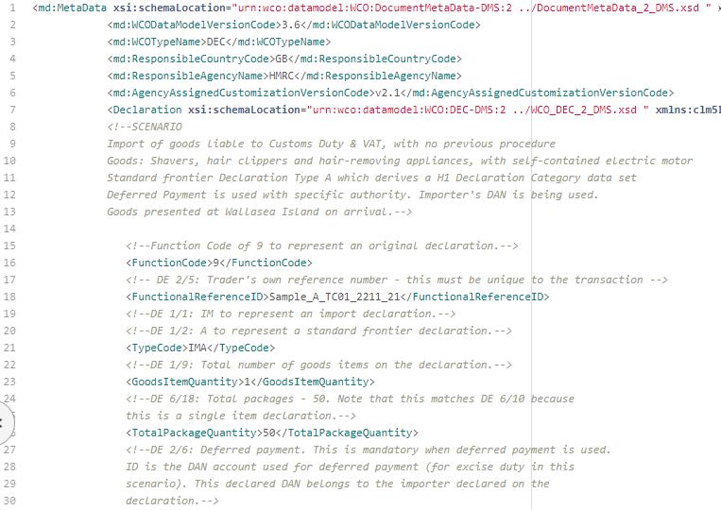
Annotations have been embedded for every data entry within the declarations
Annotations
Data Entries
All annotated information is listed between <!-- and --> for each data entry within the declaration. This ‘comments out’ the annotation within, making it no longer functional code
The Scenario description has been embedded at the top of the declaration for both Imports and Exports, outlining the key functionality being demonstrated in the test, alongside the declaration category and key information including commodity declared
Comments by data element could be extracted and shared without the xml data entries, in a similar format to previous scenario documents
Additional declaration tags have also been annotated, that do not align to a specific data element. E.g. Function code
CDS Data Elements have been annotated e.g. DE 6/18, with information about the context and meaning of each entry below
Annotations have also been embedded to further explain additional messages e.g.
Amendments
Cancellation Messages
Movement Messages
Notifications

Slide 4
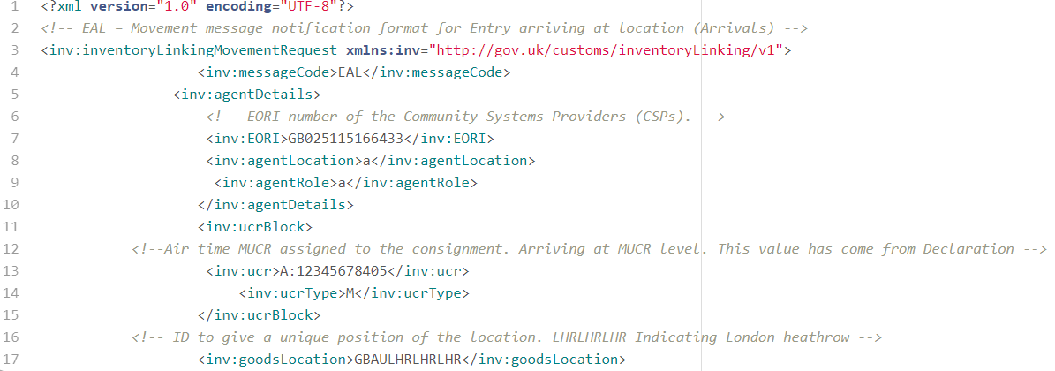
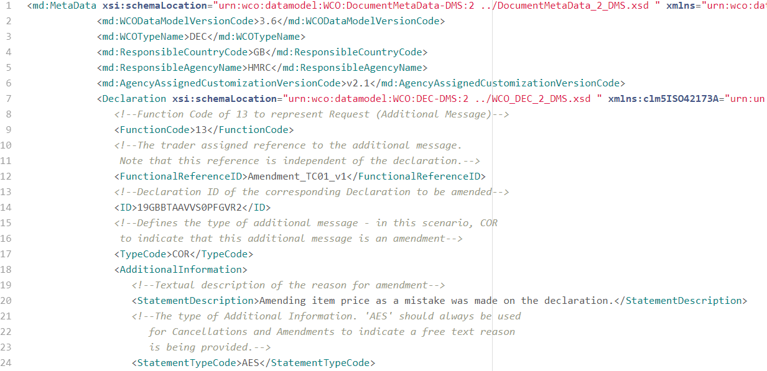
Annotations have also been embedded in additional messages
Movement Messages
Additional Messages
Annotations have also been embedded within additional messages in order to put the scenarios in context of how they could be declared . E.g.
Amendments
Cancellation Messages
Movement Messages
Notifications
These also allow multiple scenarios to be created based on a singular payload, e.g. TT_IM02a is a type Z Supplementary Declaration, which is also included with an amendment payload TT_IM02b, amending the item price
Example movement messages and notifications have also been annotated, to include data requiring updating and information on how to interpret tags
This provides a more complete declaration journey for each scenario

Slide 5
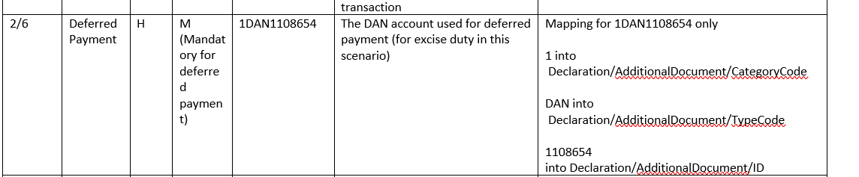
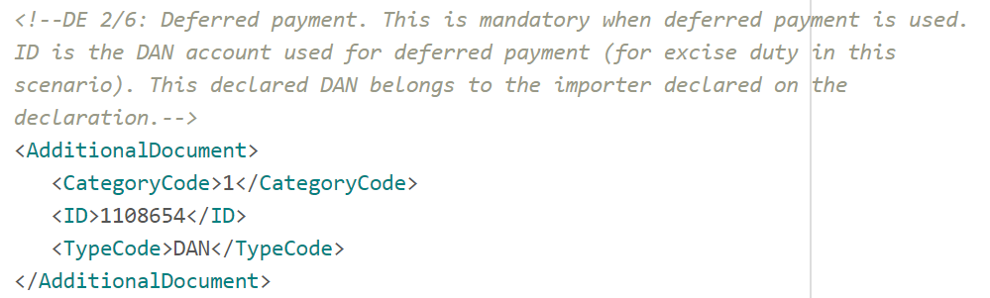
Annotations contain the same information as was originally listed in the scenario documents
Scenario Document
1
2
1
3
Annotations inserted into the payload are comprised of:
Notes from scenario document
Information from the paper tariff
Information specific to the scenario
1
XML
Information can be found un-concatenated within the declaration, reducing ambiguity around how to split longer data inputs e.g. 1DAN1108654
2
1
There is no need to map the schema in the xml declarations, therefore reducing ambiguity around this column. All items declared outside the
<GovernmentAgencyGoodsItem> tags are at header level, and within are at item level
3
2

Slide 6
A new naming convention has been developed for the annotated Trade Test samples
The new naming convention allows multiple scenarios to be shown using a single base payload, demonstrating more realistic declaration journeys
A new reference spreadsheet has been attached to describe the base payloads and additional scenarios
Scenario names progress with a number indicating a new ‘base payload’ that additional scenarios could be developed from
TT_IM02a
Annotated Sample Name | Procedure Code | Category | Scenario Description | Movement Messages | Expected Notification Messages
TT_IM02a | 4071 | H1 | Imports Type Z declaration where the agent has standing authority to use the trader’s DAN | - | DMSACC, DMSTAX_DMSCLE
TT_IM02b | N/A | n/a | TT_IM02a declaration, with a subsequent amendment to item price | - | DMSACC, DMSCLE, DMSRCV, DMSREQ, DMERES, DMSTAX
IM indicates Imports
EX indicates Exports
01 indicates first of the new annotated base payloads
These will increase sequentially
Type of declaration can be looked up in reference spreadsheet
‘a’ indicates this is the first of the scenarios created for this base payload
Additional scenario descriptions can be looked up in attached reference sheet, alongside associated notifications
Excerpt from reference spreadsheet

